Slide 1
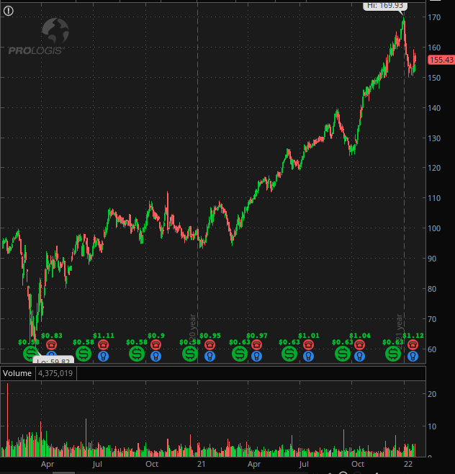
PROLOGIS (PLD) HOLDING ANALYSIS
John Phan
Company Overview:
Prologis, Inc is a top-tier logistics real estate trust (REIT) company
They acquire, maintain, and develop a portfolio of high-quality logistics real estate in the world.
Industrial REITs (85.65%) and Real Estate Service (14.35%).
4735 logistics buildings, roughly 1 billion square feet, over 19 countries
Tickers | PLD | EGP | DRE
Price | $155.43 | $199.95 | $57.63
Dividend Yield | 1.4968 | 1.9624 | 2.1308
Earnings per Share | $1.67 | $3.07 | $2.43
Price/Earnings | 38.734 | 67.595 | 72
Market Capitalization (m) | 114,914 | 8,135 | 22,009

Slide 2
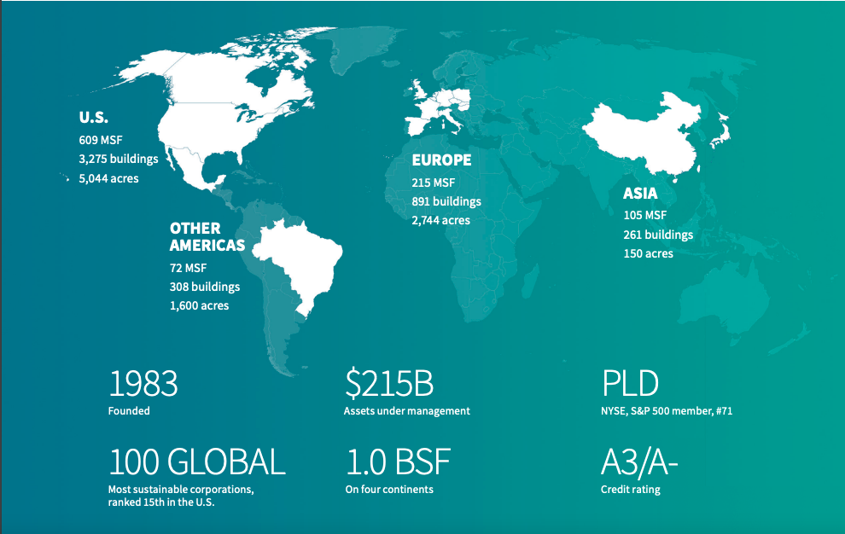

Slide 3
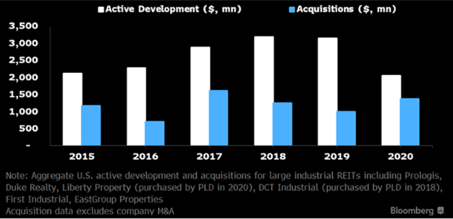
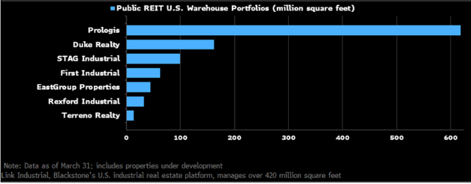
INDUSTRY TRENDS
Growing portfolios by aggressive acquisitions
E-commerce sales spikes, government stimulus checks and supply chain issues leading to high demand
E-commerce warehouses need three times the storage space than normal warehouses
“Just-in-time” to “just-in-case” inventory strategy, 10% buffer zone.
Historical low vacancy rate 4.5% and rents at strongest growth of 10.3%

Slide 4
VALUE DRIVERS
Growth – enormous property portfolio around the globe, elevated development starts and stabilizations
Industry advantage – growth in e-commerce, increase in rents, growth in demands and main supplier
Unique – innovative manufacturing designs, diversified portfolio together with multiple income streams
Power – AUM is 215 billion dollars more than 10x of Duke Realty Corporation and over 50x of EastGroup Properties

Slide 5
RECOMMENDATION
Due to value drivers and market position mentioned above until any major changes in the economy.
Diversified portfolio, market shares, multiple income streams, innovative designs.
Uptrend in e-commerce, rents and demand for industrial and logistics space with limited supply.
A HOLD recommendation for Prologis (PLD).

